Slide 1
Computational analysis identifies a sponge interaction network between long noncoding RNAs and mRNAS in human breast cancer
Paola Paci
IASI Institute of System Analysis and Computer Science
CNR-National Research Council
Roma

Slide 2
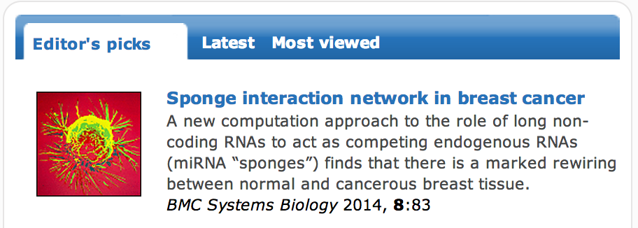

Slide 3
Background
microRNAs are important post-transcriptional regulators of gene expression by translation inhibition or degradation of their target mRNAs
new mechanism of microRNA regulation: other RNAs (both coding and non-coding) compete for microRNA binding sharing with the targets binding sites for one or more microRNAs
target mimicry in plants (2007) or competing endogenous RNA (ceRNAs) in mammals (2010-2013)
Sponges recruit microRNAs and avoid the degradation of the targets

Slide 4
References
Franco-Zorrilla, J. M. et al. Target mimicry provides a new mechanism for regulation of microRNA activity. Nature Genet. 39, 1033–1037 (2007)
Ebert,M.S.,Neilson,J.R.&Sharp,P.A.MicroRNAsponges: competitiveinhibitors of small RNAs in mammalian cells. Nature Methods 4, 721–726 (2007).
Poliseno, L. et al. A coding-independent function of gene and pseudogene mRNAs regulates tumour biology. Nature 465, 1033–1038 (2010)
Cesana, M. et al. A long noncoding RNA controls muscle differentiation by functioning as a competing endogenous RNA. Cell 147, 358–369 (2011)
Karreth, F. A. et al. In vivo identification of tumor-suppressive PTEN ceRNAs in an oncogenic BRAF-induced mouse model of melanoma. Cell 147, 382–395 (2011)
Tay, Y. et al. Coding-independent regulation of the tumor suppressor PTEN by competing endogenous mRNAs. Cell 147, 344–357 (2011)
Sumazin, P. et al. An extensive microRNA-mediated network of RNA–RNA interactions regulates established oncogenic pathways in glioblastoma. Cell 147, 370–381 (2011)
Hansen, TB et a. Natural RNA circles function as efficient microRNA sponges. Nature 495, 384–388 (2013)
Memczak, S et al. Circular RNAs are a large class of animal RNAs with regulatory potency. Nature 495, 333–338 (2013)

Slide 5
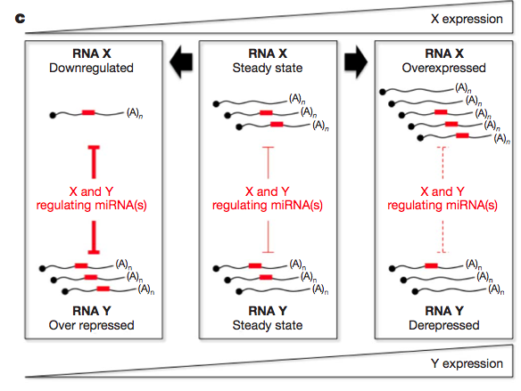
Poliseno, L. et al. A coding-independent function of gene and pseudogene mRNAs regulates tumour biology. Nature 465, 1033–1038 (2010)

Slide 6
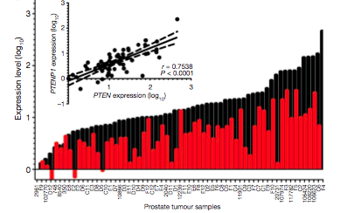
PTEN-PTENP1
PTENP1
PTEN
Poliseno, L. et al. A coding-independent function of gene and pseudogene mRNAs regulates tumour biology. Nature 465, 1033–1038 (2010)

Slide 7
Dataset
We analyzed RNA-seq data of tumor and matched normal samples of human breast invasive carcinoma (BRCA) profiled for both gene and microRNA expression, obtained from The Cancer Genome Atlas (TCGA) dataset.
The analysis was restricted to 72 individuals for which the complete sets of tumor and matched normal sequencing data - for both coding and non-coding RNAs - were available.

Slide 8
Hypotheses of the model
mRNA-lncRNA pairs must be highly correlated (ρ> 0.7)
The correlation in the selected pairs must be mediated by one or more microRNAs
The selected mRNA-lncRNA pairs must share one or more binding sites for at least one microRNA mediating their interaction

Slide 9
Partial correlation
Is it true
or false?
Long non-coding
ρ=0.8
ρ=-0.91
mRNA
microRNA
ρ=-0.87

Slide 10
Partial correlation
Direct correlation
Indirect correlation
Long non coding
Long non coding
PC=SC
S=0
PC=0
S>>0
mRNA
mRNA
microRNA
PC = Partial Correlation
SC = Simple Correlation
S = Sensitivity correlation = SC-PC

Slide 11
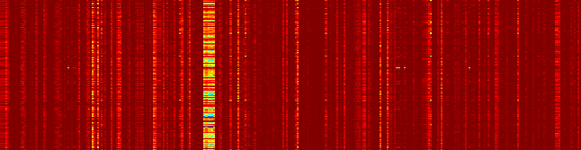
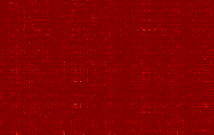
Sensitivity correlation
A
mir-205
mir-200 family
mir-31
Sensitivity correlation in normal cells
1
2
0.8
0.6
1
99th percentile
r > 0.7
Top-correlated mRNA/lncRNA
pairs in normal data set
normalized frequency
0.4
0.2
0
-1
0
1
0
mRNA/lncRNA correlation
miRNAs
B
Sensitivity correlation in cancer cells
1
2
0.8
Top-correlated mRNA/lncRNA
pairs in normal data set
0.6
1
normalized frequency
0.4
0.2
0
0
-1
0
1
miRNAs
mRNA/lncRNA correlation

Slide 12
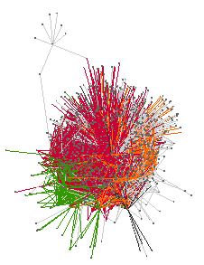
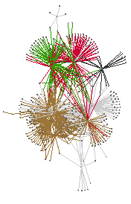
MMI-network
A
mir-205
mir-200 family
mir-31
Sensitivity correlation in normal cells
1
2
0.8
0.6
1
99th percentile
r > 0.7
Top-correlated mRNA/lncRNA
pairs in normal data set
normalized frequency
0.4
0.2
0
-1
0
1
0
mRNA/lncRNA correlation
miRNAs
B
Large sub-network
Small sub-network
mir-200 family
mir-22
mir-205
mir-378
mir-452

Slide 13
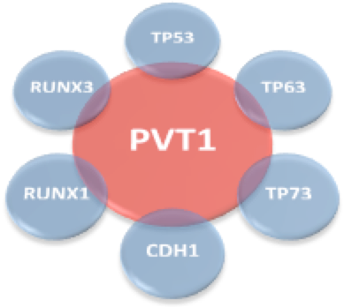
MMI-network
A
PVT1 edges in normal MMI-network
B
Nearest-neighbors of PVT1
84%
C
Large sub-network
Small sub-network
mir-200 family
mir-22
mir-205
mir-378
mir-452

Slide 14
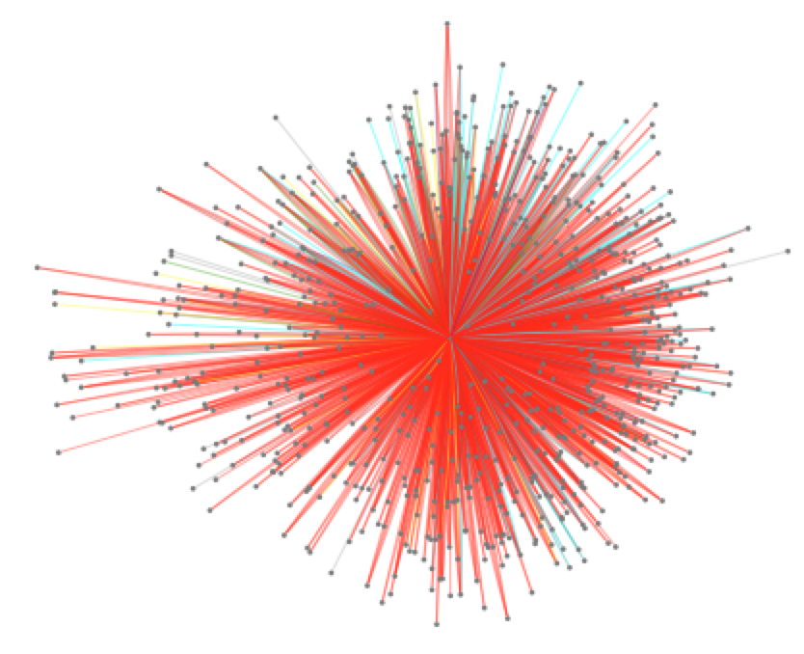
MMI-network
A
PVT1 edges in normal MMI-network
B
Nearest-neighbors of PVT1
84%
C
PVT1 sub-network
PVT1 is the first hub
PVT1 is linked to important cancer genes
PVt1 interacts with more than 50%
of the all mRNAs in the whole network

Slide 15


PVT1…ieri

Slide 16
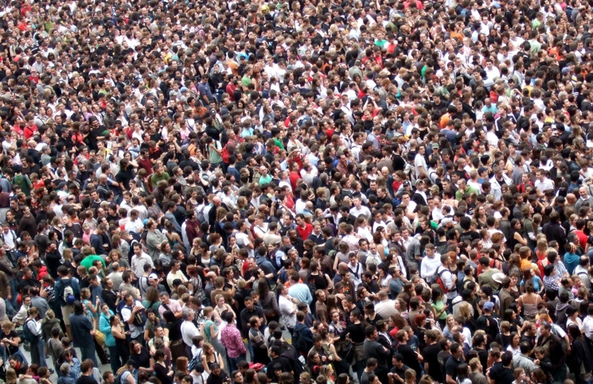
PVT1…oggi

Slide 17
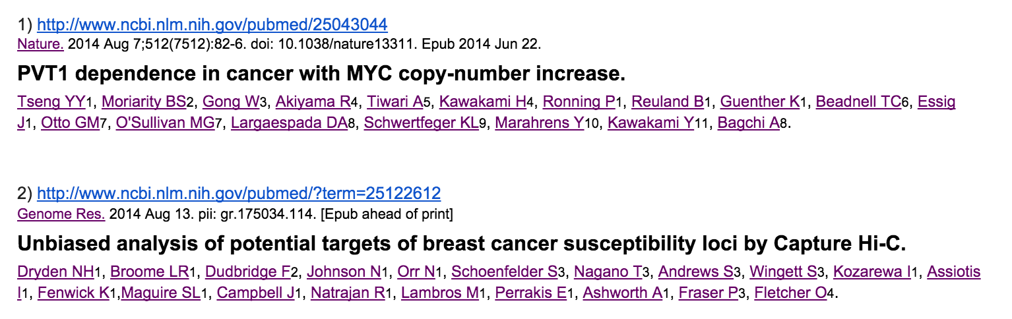
PVT1…oggi

Slide 18
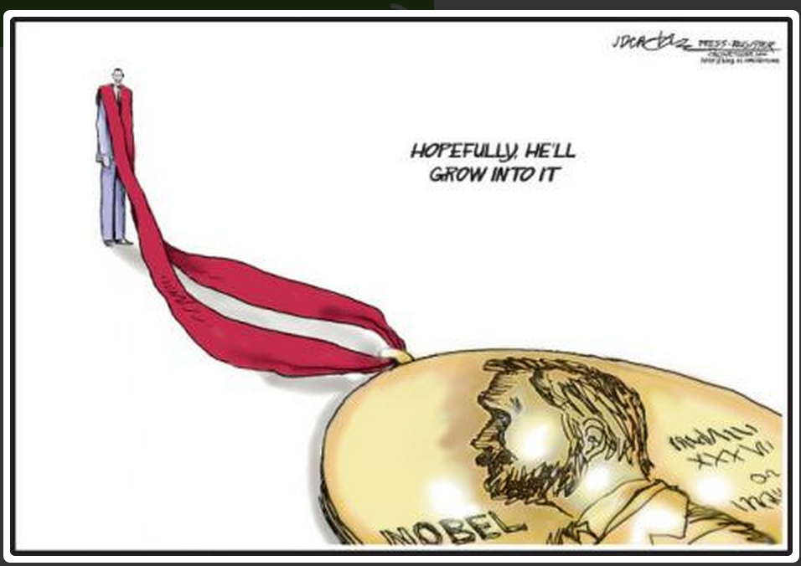
PVT1…domani?

Slide 19
P-value=3.5•10⁻¹²
PVT1
100
normal
100
cancer
Expression values
80
50
P-value=1.5•10⁻⁸
60
Average of expression values
patients
40
mir-200b
100
20
Expression values
50
0
mir-200b
PVT1
patients

Slide 20

Why PVT1 stops working
as sponge regulator of
mir-200 family in cancer

Slide 21
PVT1 isoforms
128,806,800
Chromosome 8
129,113,500
mir-200a/mir-141
mir-200b/c
Iso 1
Iso 2
Iso 3
Iso 4
Iso 5
Iso 6
Iso 7
Iso 8
Iso 9
Iso 10
Iso 11
Iso 12
Iso 13
Iso 14
Iso 15
Iso 16
Iso 17
Iso 18
Iso 19
Iso 20

Slide 22
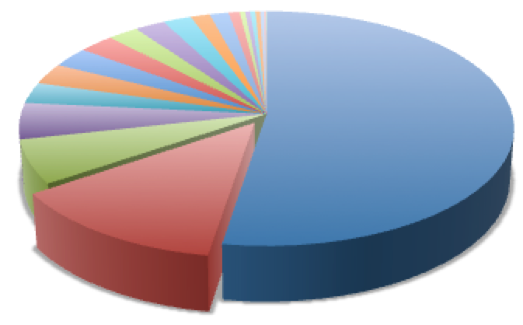
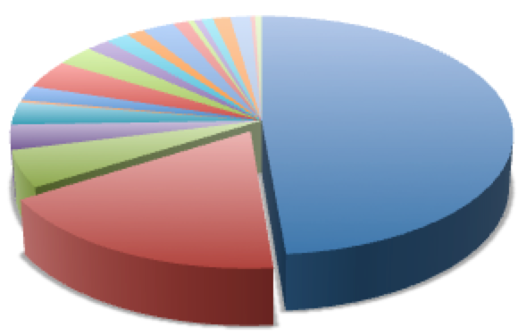
PVT1 isoforms
Normal breast
PVT1
50%
15%
TCONS_147426
TCONS_147501
Cancer breast
48%
17%
Normal
Cancer
TCONS_147426
TCONS_147501

Slide 23
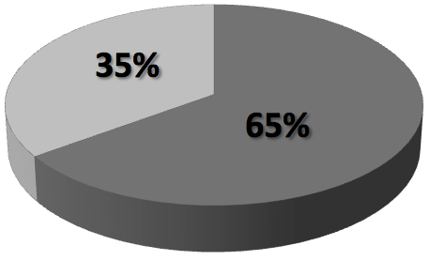
PVT1 isoforms
others
TCONS_147501
PVT1
TCONS_147426
Normal
Cancer

Slide 24
Principal component analysis
100
16
TCONS_147426
80
12
60
8
Variance explained (%)
2nd Principal component
40
4
others
20
0
TCONS_147501
0
-4
1
2
3
4
5
6
7
- 5
5
15
25
1st Principal component

Slide 25
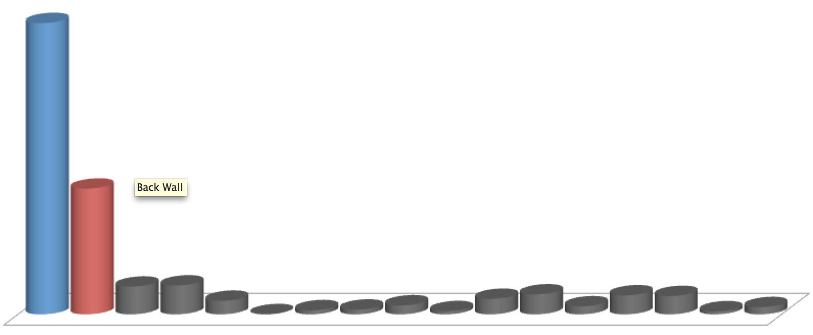
100
TCONS_147501
80
60
Isoform expression
differences (%)
TCONS_147426
40
20
OTHERS
0
100
normal
80
cancer
60
Isoform abundance (%)
P-value=0.9
40
P-value=2.3•10⁻⁵
20
0
mir-200b
TCONS_147501
TCONS_147426

Slide 26
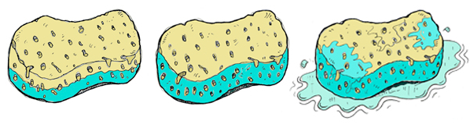
ACTIVE SPONGE
NON-ACTIVE SPONGE
Not saturated – it could
hold more
Saturated
Beyond saturation – it can’t
hold more
100
normal
80
cancer
60
ACTIVE SPONGE
NON-ACTIVE
SPONGE
Percentage of abundance
40
20
0
mir-200b
TCONS_147426
mir-200b
TCONS_147426

Slide 27
Conclusions
The analysis of the complex interactions between messenger RNAs, long non-coding RNAs and microRNAs in BRCA highlighted a marked rewiring of the sponge program between normal and cancer tissues
The main actors of this rewiring are PVT1 and mir-200 family, both up-regulated in cancer
The breakdown of their sponge interaction in cancer could be due to a drastic decrease in the relative concentration between mir-200 family and the PVT1 red isoform
The isoform lacking the binding site for the mir-200 family results the most up-regulated.

